Slide 1
CS 4421
Operating Systems II
Chapter 6: Process Synchronization

Slide 2
Overview of today’s lecture
Introduction
Process Synchronization Problem
Critical Region and Implementation
Process Synchronization Mechanisms
Pipes and Implementation
Message Passing

Slide 3
Introduction
OS consists of many concurrent processes and threads
Each process or thread may execute in two different modes:
  kernel mode,
    all processes and threads share the same address space of the OS kernel
  user mode,
    each process executes in a unique address space but threads in a process share the same address space of the process
When concurrent processes or threads execute in the same address space, they may access and modify common data objects in the shared address space
Process synchronization
  refers to the mechanisms and rules used to ensure the integrity of shared data objects in a concurrent execution environment

Slide 4
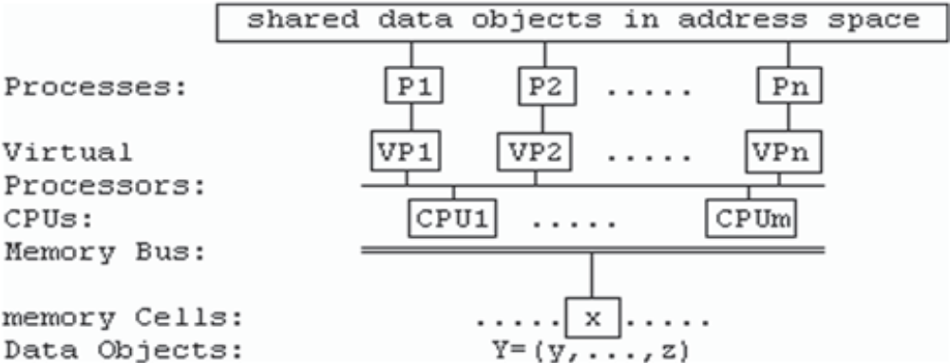
Introduction
Figure above shows a system of concurrent processes
  n processes: P1 to Pn share some data objects in their address space
  Each process runs on a virtual processor, VP1 to VPn
  VPs may be mapped to a real CPU, CPU1 to CPUm, by multitasking on the CPUs
  The CPUs access data objects in physical memory, denoted by x and Y = (y, … ,z), which are in the shared address space of the processes
When accessing shared data objects processes must be synchronized to ensure the integrity of the shared data objects

Slide 5
Overview of today’s lecture
Introduction
Process Synchronization Problem
Critical Region and Implementation
Process Synchronization Mechanisms
Pipes and Implementation
Message Passing

Slide 6
Process Synchronization Problem
Assume that int x = 0 is in the address space of many processes
  all try to update x by x = x + 1
The update operation consists of three steps:
  Step 1: read x from memory into CPU;
  Step 2: increment x by 1 inside CPU;
  Step 3: write x back to memory;
Assume that a process P1 has executed Step 1 but not yet Step 2 and Step 3
At the same time, assume another process P2 executes Step 1 also
  P2 would read the old value of x, which is still 0
Then P1 executes S2 and S3, which change x to 1
Then P2 executes S2 and S3, which write 1 to x again
  The value of x is still 1
Since both P1 and P2 have incremented x by 1, the value of x should be 2, not 1
If either process completes the sequence of steps 1 to 3 before another process is allowed to do the same,
  the result will be correct regardless of the execution order of the processes

Slide 7
Process Synchronization Solution
In order to ensure the exclusive use of x, we may try to protect x as follows:
  int s = FREE if x is available, BUSY otherwise;
  Any process which needs to update x must check the status variable s, as in
  check:
  if (s == FREE){
  s = BUSY; // acquire x
  x = x + 1;
  s = FREE; // release x
  }
  else{ // x not available, what to do?
  option 1 : goto check; // keep trying
  option 2 : sleep(&s); goto check; // workable but must retry
  option 3 : block the process; when the process runs again,
  it is guaranteed to have x;
  }
But what if several processes may arrive at the label check at the same time?
  all such processes would see s as FREE before any of them has changed it to BUSY
It can be seen the status variable itself needs protection also
  Thus, the mutual exclusion problem is recursive in the sense that the problem repeats itself
  The recursion must stop somewhere. otherwise the problem would have no solution

Slide 8
Process Synchronization Solution
Next, assume that we can protect the status variable s to make the above code work
  What should a process do if it finds s BUSY?
In option 1, the process repeatedly checks the status variable until it succeeds, this is known as a spinlock
  Viable in multiprocessor systems but not a good option in uniprocessor systems
In option 2, the process goes to sleep to wait for x
  This is inefficient as the process must must execute the check code again
In option 3, the process blocks itself to wait for x
  When a blocked process runs again, it is guaranteed to have the resource so that it does not need to retry again
Under normal conditions, option 3 would be the best
  This shows that process synchronization can be achieved by using different kinds of tools

Slide 9
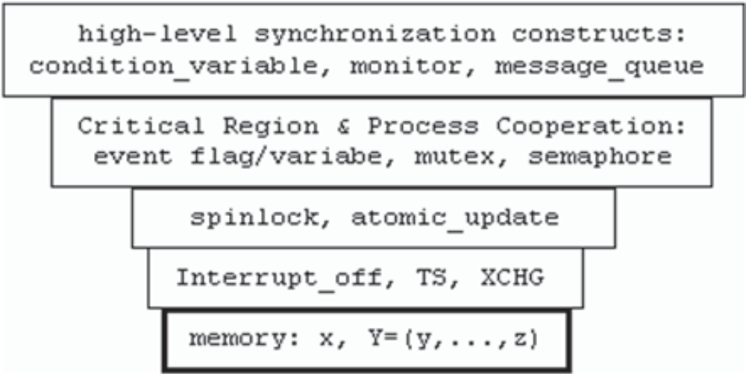
Process Synchronization Solution
Figure below shows the hierarchy of process synchronization tools
Each level includes more mechanisms with improved functionality,
  all of which depend on the mechanisms at lower levels
At the lowest level, disabling CPU interrupts ensures only one process is running on a CPU
Machine instructions TS and XCHG are for modifying memory locations as atomic or indivisible operations
Above the level of atomic instructions are synchronizing tools implemented in software

Slide 10
Overview of today’s lecture
Introduction
Process Synchronization Problem
Critical Region and Implementation
Process Synchronization Mechanisms
Pipes and Implementation
Message Passing

Slide 11
Critical Region
A Critical Region (CR) or Critical Section
  is a sequence of operations on shared data objects by only one process at a time
  are intended to protect shared data objects, not code
Consider the following code segment:
SHARED int s;
-----------------------------------------
inc_s(int *s) | dec_s(int *s)
{ | {
(*s)++; | (*s)--;
} | }
-----------------------------------------
Processes: inc_s(&s); dec_s(&s);
  Both inc_s() and dec_s() modify the shared variable s
  CR here is associated with the shared variable s, not the individual pieces of code that operate on s
  If a process is already executing inc_s(),
    no other process should be allowed to execute inc_s(), dec_s() or any other code that operate on s at the same time
Critical regions realize the principle of process mutual exclusion, which is the basis of process synchronization

Slide 12
Implementation of Critical Region
Assume that x is an addressable memory location and only one CPU can access x at a time
  thus read(x) and write(x) are atomic operations
  however, the individual atomicity of read and write does not guarantee that x can be updated correctly
    This is because updating x requires read(x) and then write(x) in two steps
      Between the two steps other CPUs may cut in
  To remedy this, CPUs designed for multiprocessing usually support a Test-and-Set (TS) or equivalent instruction
    TS(x) = {read x from memory; test x for 0 or 1; write 1 to x}
    No matter how many CPUs try to do TS(x), even at the same time, only one CPU can read x as 0, all others will read x as 1
    the Intel x86 CPU equivalent instruction is XCHG
      exchanges a CPU register with a memory location in a single indivisible operation

Slide 13
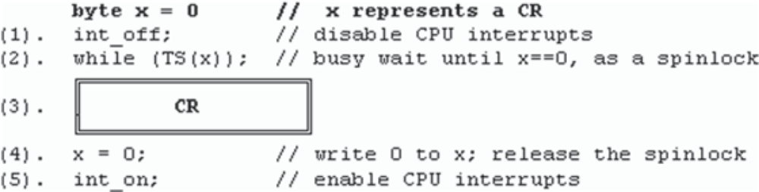
Implementation of Critical Region
With the TS or equivalent instruction, we can implement a CR associated with x as follows
  Step (1), disable CPU interrupts to prevent process switching
  Step (2), the process loops until TS(x) gets a 0 value
  Step (3), the process sets x to 1 and enters the critical region
  Step (4), when the process finishes the CR, it sets x to 0
  Step (5), the process enables CPU interrupts to allow process switching
NB: spinlocks are convenient to use in multiprocessor systems when the CR duration is short
  For uniprocessor systems, spinlock is not necessary and can be omitted

Slide 14
Overview of today’s lecture
Introduction
Process Synchronization Problem
Critical Region and Implementation
Process Synchronization Mechanisms
Pipes and Implementation
Message Passing

Slide 15
Process Synchronization Mechanisms
With the basic CR, we can implement other mechanisms for process synchronization:
  Sleep/Wakeup and,
  Semaphore

Slide 16
Sleep/Wakeup
sleep/wakeup works only for UP kernels as only one process runs at a time
Process switch takes place only when the running process
  terminates,
  goes to sleep or becomes STOPPED or BLOCKed,
  has finished kernel mode execution and is about to return to user mode
When a process executes sleep or wakeup in kernel, it cannot be interfered
  thus it suffices to disable interrupts upon entry to sleep or wakeup, and enable interrupts when the execution finishes
Since sleep and wakeup may be called with interrupts disabled,
  they should restore CPU’s original interrupt mask rather than always enable interrupts at the end

Slide 17
Semaphore
A semaphore is a data structure
struct semaphore{
byte lock; // represents a CR; initial value = 0;
int value; // initial value of semaphore
PROC *queue; // a FIFO queue of BLOCKed processes
}s;
  lock = 0 represents the CR,
  value is the initial value of the semaphore and
  queue is a FIFO queue of processes blocked on the semaphore
All operations on a semaphore must be performed in the same CR of the semaphore’s lock e.g.
------------------------------------------------------
enterCR(byte *lock) | exitCR(byte *lock)
{ | {
int_off; | *lock = 0;
while(TS(*lock)); | int_on;
} | }
------------------------------------------------------

Slide 18
Semaphore
The most well-known operations on semaphores are P and V, which are defined as follows:
-----------------------------------------------------------
P(struct sempahore *s) | V(struct semaphore *s)
{ | {
enterCR(&s->lock); | enterCR(&s->lock);
s->value--; | s->value++;
if (s->value < 0) | if (s->value <= 0)
BLOCK(s); | SIGNAL(s);
else exitCR(&s->lock); | exitCR(&s->lock);
} | }
-----------------------------------------------------------
BLOCK(s) blocks the process in the semaphore’s FIFO queue, and
SIGNAL(s) unblocks the first process from the semaphore's FIFO queue
--------------------------------------------------------------------
BLOCK(struct semaphore *s) | SINGAL(struct semaphore *s)
{ | {
running->status = BLOCK; | PROC *p;
enqueue(&s->queue,running); | p = dequeue(&s->queue);
s->lock = 0; // only for MP | p->status = READY;
switch process; int_on; | enqueue(&readyQueue, p);
} | }
--------------------------------------------------------------------

Slide 19
Process Synchronization in MTX
We will use a mixture of process synchronization tools in our OS
  For process management,
    we use sleep/wakeup because they are easy to understand and compatible with Unix
  For resource management,
    we use semaphores because each V operation unblocks only one waiting process, which eliminates unnecessary process switching
  In file system and device drivers,
    we also use semaphores because they simplify the transition from uniprocessor environment to SMP on multiprocessor systems

Slide 20
Overview of today’s lecture
Introduction
Process Synchronization Problem
Critical Region and Implementation
Process Synchronization Mechanisms
Pipes and Implementation
Message Passing

Slide 21
Pipes
Pipes are unidirectional inter-process communication channels for processes to exchange data
A pipe has a read end and a write end
  Data written to the write end of a pipe can be read from the read end of the pipe
Some systems though, allow pipes to be bidirectional
  data can be transmitted in both directions
Ordinary pipes are for related processes
Named pipes are FIFO communication channels between unrelated processes
Reading and writing pipes are usually synchronous and blocking
Some systems support non-blocking and asynchronous read/write operations on pipes
For simplicity,
  we shall consider a pipe as a finite-sized FIFO communication channel between a set of related processes

Slide 22
Pipe Synchronization
A process can only be either a reader or a writer on a pipe, but not both
  After creating a pipe, the process forks a child process to share the pipe
    The user must designate one of the processes as a writer and the other one as a reader of the pipe.
    The order does not matter as long as each process is designated to play only a single role
Reading from a pipe,
  if the pipe has data, the reader reads as much as it needs and returns the number of bytes read
  if the pipe has no data but still has writers, the reader waits for data
    when a reader reads data from the pipe to create more room, it wakes up the waiting writers allowing them to continue
  if the pipe has no data and also no writer, the reader returns 0
    the reader can stop reading from the pipe
Writing to a pipe,
  if the pipe has room, it writes as much as it needs to or until the pipe is full
  if the pipe has no room but still has readers, the writer waits for room
    when a writer writes data to a pipe, it wakes up the waiting readers, allowing them to continue
  if a pipe has no more readers, the writer must detect this as a broken pipe error and aborts

Slide 23
Implementation of Pipes in MTX
First, a process creates a pipe by the syscall pipe(pd[2])
typedef struct pipe{
char buf[PSIZE]; // circular data buffer
int head, tail; // circular buf index
int data, room; // number of data & room in pipe
int nreader, nwriter; // number of readers, writers on pipe
}PIPE;
  A PIPE object has a read end and a write end
    Each end is represented by an Open File Table (OFT) object
typedef struct oft{
int mode; // READ_PIPE|WRITE_PIPE
int refCount; // number of PROCs using this pipe end
struct pipe *pipe_ptr; // pointer to the PIPE object
}OFT;
  From a process point of view, it can access a PIPE object if it has pointers to the PIPE's OFTs
    Thus, we add a field OFT *fd[NFD] to every PROC structure
  Each index of the fd [] array is called a file descriptor
    When a process opens a file, it uses a free entry in the fd[] array to point at the OFT of the opened file

Slide 24
/*------ Algorithm of pipe creation: pipe(int pd[2]) ----------*/
1. Add a file descriptor array, fd[NFD], to every PROC structure:
typedef struct proc{
// same as before
OFT *fd[NFD]; // opened file descriptors; copy on fork()
int kstack[SSIZE];
}PROC;
2. Allocate a PIPE object. Initialize the PIPE object with
head=tail=0; data=0; room=PSIZE; nreaders=nwriters=1;
3. Allocate 2 OFTs. Initialize the OFTs as
readOFT.mode = READ_PIPE; writeOFT.mode = WRITE_PIPE;
both OFT's refCount=1 and pipe_ptr points to the same PIPE object.
4. Allocate 2 free entries in the PROC.fd[] array,e.g.fd[i] and fd[j].
Let fd[i] point to readOFT and fd[j] point to writeOFT.
5. write index i to pd[0] and index j to pd[1]; both are in Uspace.
6. return 0 for OK;

Slide 25
Implementation of Pipes in MTX
After creating a pipe, the process must fork a child to share the pipe
  Modify fork() to let the child process inherit all the opened file descriptors of the parent
int fork() { // same modifications to vfork():
// same as before but Add copy opened file descriptors
// assume PROC *p points at the child PROC
for (int i=0; i<NFD; i++){
if (running->fd[i]){ // copy only non-zero entries
p->fd[i] = running->fd[i];
p->fd[i]->refCount++; // inc OFT.refCount by 1
if (p->fd[i]->mode == READ_PIPE)
p->fd[i]->pipe_ptr->nreader++; // pipe.nreader++
if (p->fd[i]->mode == WRITE_PIPE)
p->fd[i]->pipe_ptr->nwriter++; // pipe.nwriter++
}
}
}

Slide 26
Implementation of Pipes in MTX
After fork, both processes have 2 file descriptors;
  pd[0] for reading from the pipe and pd[1] for writing to the pipe
    Since a process can only be either a reader or a writer but not both, each process must close an unwanted pipe end
/*---------------------- Algorithm of close_pipe : close(int fd) -----------------------*/
1. Validate fd to make sure it's a valid opened file descriptor
2. Follow PROC.fd[fd] to its OFT. Decrement OFT.refCount by 1;
3. if (WRITE_PIPE){
decrement nwriter by 1;
if (nwriter==0){ // last writer on pipe
if (nreader==0)
deallocate PIPE;
deallocate writeOFT;
}
wakeup(data); // wakeup ALL blocked readers
}
4. else{ // READ_PIPE
decrement nreader by 1;
if (nreader==0){ // last reader on pipe
if (nwriter==0)
deallocate PIPE;
deallocate readOFT;
}
wakeup(room); // wakeup ALL blocked writers
}
5. Clear caller's fd[fd] to 0; return OK;

Slide 27
Implementation of Pipes in MTX
The read and write pipe algorithms
/*---------------- Algorithm of read_pipe ----------------*/
int read_pipe(int fd, char *buf, int n) {
int r = 0;
if(n<=0)
return 0;
validate fd; from fd, get OFT and pipe pointer p;
while(n) {
while(data) {
read a byte from pipe to buf;
n--; r++; data--; room++
if(n==0)
break;
}
if(r) { // has read some data
wakeup(room);
return r;
}
// pipe has no data
if (nwrite) { // if pipe still has writer
wakeup(room); //wakeup ALL writers, if any
sleep(data); // sleep for data
continue;
}
// pipe has no writer and no data
return 0;
}
}

Slide 28
/*---------------- Algorithm of write_pipe ----------------*/
int write_pipe(int fd, char *buf, int n) {
int r = 0;
if(n<=0)
return 0;
validate fd; from fd, get OFT and pipe pointer p;
while(n) {
if(!nreader) // no more readers
kexit(BROKEN_PIPE); // BROKEN_PIPE error
while(room) {
write a byte from buf to pipe;
r++; data++; room--; n--;
if(n==0)
break;
}
wakeup(data); // wakeup ALL readers if any
if (n==0)
return r; // finished writing n bytes
// still has data to write but pipe has no room
sleep(room); // sleep for room
}
}

Slide 29
Implementation of Pipes in MTX
On process’ exit, closes all opened file descriptors
  So we modify kexit() in the kernel to close opened pipe file descriptors
To support pipe operations, we add pipe related syscalls to the our kernel
case 30 : r = kpipe(b); break;
case 31 : r = read_pipe(b,c,d); break;
case 32 : r = write_pipe(b,c,d); break;
case 33 : r = close_pipe(b); break;
case 34 : r = pfd(); break;
  pfd() displays the opened pipe descriptors of the running process
The complete source code can be found on thuto
  MTX6.pipe1 and MTX6.pipe2 demonstrate pipes in our OS

Slide 30
Overview of today’s lecture
Introduction
Process Synchronization Problem
Critical Region and Implementation
Process Synchronization Mechanisms
Pipes and Implementation
Message Passing

Slide 31
Message Passing
Message passing allows processes to communicate with one another by exchanging messages
Since processes have distinct (Umode) address spaces, they cannot access each other's memory area directly
  Therefore, message passing must go through the kernel
For simplicity, we shall assume that message contents are text strings of finite length
  We also assume that the kernel has a finite set of message buffers
typedef struct mbuf{
struct mbuf *next; // pointer to next mbuf
int pid; // sender pid
int priority; // message priority
char contents[128]; // message contents
}MBUF; MBUF mbuf[NMBUF]; // NMBUF = number of mbufs

Slide 32
Message Passing
Initially, all message buffers are in a free mbufList
To send a message, a process must get a free mbuf first
After receiving a message, it releases the mbuf as free
Since the mbufList is accessed by many processes, it is a CR and must be protected
  So we define a semaphore mlock = 1 for processes to access the mbufList exclusively
MBUF *get_mbuf() {
P(mlock);
MBUF *mp = dequeue(mbuflList);
V(mlock);
return mp;
}
int put_mbuf(MBUF *mp) {
P(mlock);
enqueue(mbufList)
V(mlock);
}

Slide 33
Message Passing
Asynchronous Message
  In the asynchronous message passing scheme, both send and receive operations are non-blocking
  If a process cannot send or receive a message, it returns a failed status, in which case the process may retry the operation again later
  Asynchronous communication is intended mainly for loosely-coupled systems, in which inter-process communication is infrequent
Synchronous Message
  In the synchronous message passing scheme, both send and receive operations are blocking
  A sending process must “wait” if there is no free mbuf
  Similarly, a receiving process must “wait” if there is no message in its message queue
  Synchronous communication is more efficient than asynchronous communication
  Well suited to tightly-coupled systems in which processes exchange messages on a planned or regular basis

Slide 34
Server-Client Message Passing
In a simple server-client communication system, there are two processes; servers and clients
  After sending a request to a server, a client immediately waits for a reply since there is nothing else the client can do
  Upon receiving a client request, a server handles the request, sends a reply to the client
  A server blocked in recv() will be unblocked by a client request
  Similarly, a client blocked in recv() will be unblocked by a server reply
The simple server-client model can be extended to handle multiple levels of clients and servers
  processes are divided into levels, 1 to N, where 1 is the lowest and N is the highest level
  process at level-1 is a client, which can only send a request and immediately waits for a reply
  process at level-N is a server, which can only receive a request, handle it and
  send a reply to the client
  process at level i, (1 < i < N), can be both a server and a client
    As a server, it may receive requests from clients at lower levels
    As a client, it may send requests to higher level servers

Slide 35
Server-Client Message Passing
MTX6.message2 demonstrates multi-level message passing
  When the system starts, P1 begins to run u1 in Umode
    fork several processes, e.g. P2 to P6, at different levels
    The process levels are assigned in init() as (P1, P2) at level-1, (P3, P4) at level-2, (P5, P6) at level-3, etc.
  In this case, (P1, P2) can only be clients
  (P3, P4) can be both server and client
  (P5, P6) can only be servers if there is no process above level-3
Multi-level server-client message passing is not intended as a general mechanism for IPC
  It is suitable for systems with a hierarchical communication organization, such as microkernel based operating systems
  A microkernel is a kernel with only the essential functions of an operating system, such as process scheduling and message passing.
  All other functions, such as process management, memory management, device drivers and file system, etc. can be implemented as server processes
In this sense, MTX6.message2 as a microkernel, but it is far from being a complete operating system

Slide 36
Next Lecture
Reading
  Chapter 7 - Memory Management

